Slide 1
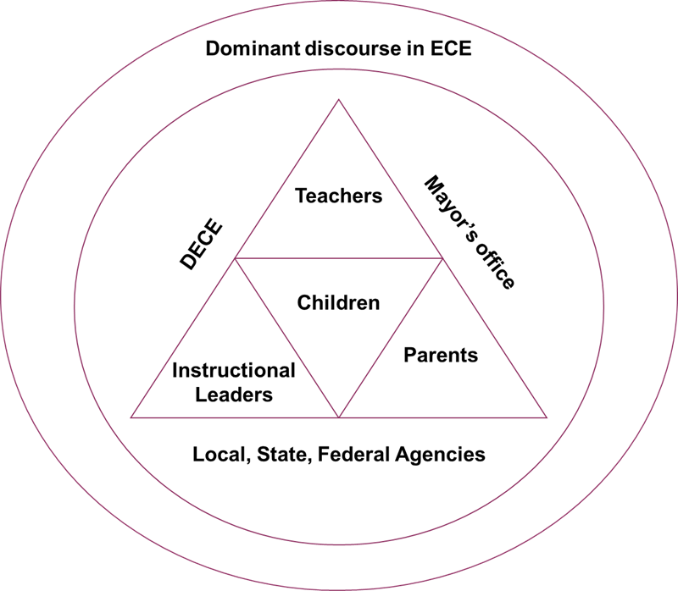
.2
Case Studies on Authentic Assessment:
Perspectives on Fidelity, Utility, and Applications to Practice
Lacey E. Peters, PhD and Sherryl Browne Graves, PhD, Eva Liang, and Sanae Akaba, PhD
Hunter College, City University of New York
Background
Purpose
Findings
PKF policy mandates require teachers use one of three authentic assessment systems (AAS)
This study investigates how AAS influence the daily practices of PKA teachers and how teachers use assessment to develop a deeper understanding of children’s individual needs and interests.
We utilized a multiple case study design to obtain qualitative and quantitative perspectives on the adoption of authentic assessment in PKA programs.
Each case study presents a story about the lived realities of teachers and other actors within the early childhood community during the period of the PKA expansion. These stories are complex and illustrate the multifaceted impacts of the adoption of authentic assessment and the PKA expansion
Demonstrate how teachers find and use effective assessment strategies to support their pedagogical decision-making
Examine the supports teachers are provided by their program’s administration or other entities that reinforce their work around curriculum and assessment, shedding light on what is most to least helpful in their training or professional learning
Obtain parents’ perspectives about their experiences with PKA and their knowledge of children’s growth and learning
AAS are expanding teachers’ assessment literacies
It (Teaching Strategies) helps me to know what they’re expected to do at a certain age and time throughout the school year and what I need to target within that time frame. Um and then whatever's in, on TSG, how can I incorporate those skills to make sure that that specific child or all the children can be able to achieve that goal.” (Head Teacher, DOE sponsored NYCEEC)
AAS can also limit teachers’ agency around decision-making
Teachers want to be involved in decision making processes
Part of the reason I decided to do this with all of you is because we feel like we’re getting a little bit of a voice, you know, because there is an importance to what we do. It’s our life. It’s not only our livelihood, it’s our passion. It’s something we love and it’s nice that someone is recognizing that we are here. (Head teacher, Public School)
I just got a whole new way that we’re doing lesson plans. I was just in an hour meeting and we were given, we’re doing it the DOE way. So that’s different for us and that’s a lot more work. Constantly writing reports. Authentic Assessment. (Head Teacher, NYCEEC)
Data Sources
Administrators
Surveys
Children
Interviews
Theoretical Framework
We draw from the Critical Ecology of the EC Profession (Dali, Miller, & Urban, 2012) to encourage teachers to transform practices and policies within systems through critical reflection, inquiry, and responsiveness in their local contexts
Teachers/Assistant Teachers
Classroom Observations
Understandings
Parents
Our data reveal both the tensions and possibilities that teachers and other actors in EC programs experience during policy and programmatic shifts
It is essential to include teachers in on-going and collaborative work to bridge policy and practice so that they gain a greater sense of agency and efficacy, empowerment and advocacy as decisions are made about the early childhood profession, their roles as educators, and Pre-K education.
Research Participants
10 PKA Programs
1 Public School
4 DOE Sponsored Programs
5 NYCEECS
Data collection: 2016-201z academic year.
11 Instructional Leaders
17 Head Teachers
10 Assistant Teachers
10 PKA Programs
31 Parents
Program’s Adoption of AAS
Teaching Strategies | ••••••
Child Observation Record | ••
Work Sampling | ••
Acknowledgements
This study is funded by the Foundation for Child Development
We are thankful for all of the teachers, instructional leaders, parents, an children who participated. We are grateful to all the hard work from our research team. Much appreciation to the Foundation for Child Development and the NYC Early Childhood Research Network for their generous support.
* DECE – Division of Early Childhood Education

