Slide 1
Infant-Toddler Course Content and the Teacher Education Pipeline in New York State
Jennifer Gilken, Jennifer Longley, Jillian Crosby, Borough of Manhattan Community College

Slide 2
Working with infants and toddlers requires a unique skill set that is different than working with children over three (McMullen & Apple, 2012).

Slide 3
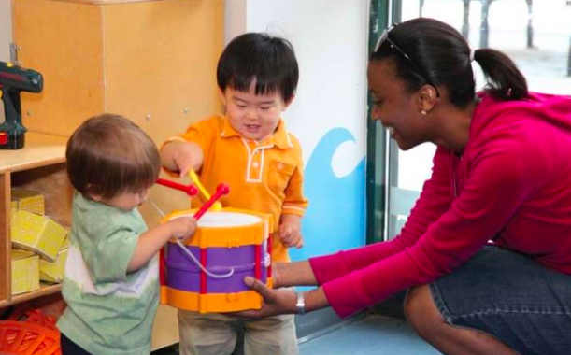
New York State Department of Education certifies individuals to teach children from birth through grade 2 but recent research posits that early childhood degree programs lack emphasis on course content related to: *Infant and toddler development and learning *Relationship-based practices *Field experiences in infant-toddler classrooms

Slide 4
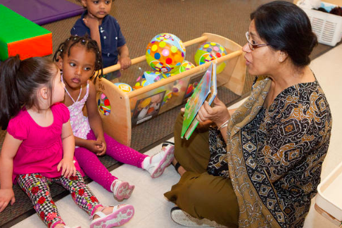
Transforming the Workforce for Children Birth Through Age 8: A Unifying Foundation (IOM & NRC, 2015), includes among its recommendations:
Transitioning to a minimum requirement of a bachelor’s degree, with specialized knowledge and competencies, for all lead teachers working with children from birth to age eight.
The development and enhancement of interdisciplinary higher education programs for early care and educational professionals, including practice-based and supervised learning opportunities.

Slide 5
The goal of our research was to investigate:
How are the course content and fieldwork experiences in New York State undergraduate early childhood teacher education programs preparing preservice professionals to work with infants-toddlers and families?
How are the best practices identified for working with infants, toddlers and families included in course content and fieldwork opportunities in New York undergraduate early childhood programs?
What is the effectiveness of the infant-toddler pipeline for educators?

Slide 6
Methods
This research was an exploratory case study. Participants were faculty and students, currently enrolled and alumni, in NYS early childhood education (ECE) undergraduate teacher preparation programs. The research involved three phases of data collection:
Phase 1:
Created Crosswalk
Reviewed courses
Initially for 8 infant-toddler crosswalk elements
Revised process to code (Creswell 2003, 2008)
Course descriptions
Course names

Slide 7
Methods
Phase 2:
Faculty who teach in NYS undergraduate ECE programs were contacted to complete Chu’s (2016) Early Childhood Higher Education Program Self-Assessment for Infant-Toddler Content survey.
The self-assessment asked faculty to rate two components of a course: 1) the frequency or depth that eight infant-toddler teacher competencies occur within the course content, and 2) the level of field application within the course.
Phase 3:
Focus groups were conducted with students who:
Completed their CDA.
Completed an Associates with a specialization in working with infants and toddlers then transferred to a 4-year college.
Went directly into the field after completing their Associates degree with a specialization in working with infants and toddlers.

Slide 8
Crosswalk - Modeled after Chu (2016)
Element | Zero to Three | NAEYC | CUPID | MAIMH -IFA
Understand holistic child development | Domain 1 | Standard 1 | Supporting Development & Learning (DVL) | Competency 1
Use Relationship-based practices | Domain 3 | Standard 5 | Building & Supporting Relationships (REL) | Competency 5
Observe, Assess & Communicate | Domain 8 | Standard 3 | Assessing Behavior, Development, & Environments (ABD) | Competency 4
Use Family-Centered Practices | Domain 2 | Standard 2 | Partnering and Supporting Diverse Families (FAM)
Create Environments | Domain 4
Understand Program Structures | Domain 6 |  |  | Competency 3
Use Reflective & Ethical Practices | Domain 7 | Standard 6 | Reflective Practice (RFP) | Competency 2 & 7
Use Culturally Sustaining Practices | Domain 5 | Standard 4

Slide 9
Preliminary Results
Phase 1: 4-year programs | Phase 1: 2-year programs | Phase 2: Faculty Survey | Phase 3: Focus Groups
40 four-year programs; 578 courses reviewed 102 courses (18%) mention 0-36 months 4 courses (0.01%) dedicated to infants-toddlers 26 courses (5%) included time in classrooms with children 0-36 months | 27 two-year programs; 208 courses reviewed 69 courses (33%) mention 0-36 months 24 courses (12%) dedicated to infants-toddlers 20 courses (10%) include time in classrooms with children 0-36 months | 490 surveys emailed to NYS early childhood faculty 72 responses (15%) response rate Fieldwork questions: 69% completion rate 70% of respondents (35) provide infant-toddler fieldwork placements Faculty report infant-toddler course content embedded/included/infused into ECE courses | Transfer students: Limited opportunity to continue their focus on working with infants & toddlers in 4-years programs System challenges to transferring Graduates who entered the field: Limited opportunities for professional learning focused on infants & toddlers Need to continually reexamine curriculum to be relevant for workforce development

Slide 10
Recommendations for Policy and Practice
NYS ECE undergraduate programs:
Increase learning experiences specific to working with infants-toddlers
Fieldwork placements with children under 3
Dedicated infant-toddler courses.
Expand upon core concepts in ECE undergraduate programs to prepare infant-toddler teachers:
Creating environments
Reflective & ethical practices
Use of family-centered practices
Relationship-based practices
Build faculty capacity
Recruit faculty/practitioners with experience/expertise working with infants-toddlers & families
Offer opportunities for faculty development around infant-toddler development & curriculum
Support research focused on infants- toddlers and the infant-toddler workforce

Slide 11
Recommendations for Policy and Practice
The teacher education pipeline:
Transfer
Promote transferable credits
Ensure a system that supports transfer (CDA, A.S., Bachelor’s degree)
Create seamless articulation agreements between CDA programs, Associate's, and Bachelor’s degrees that embrace infant-toddler coursework
Credentialing
Provide multiple certified professional learning curriculum for the infant-toddler workforce, which could be linked to QUALITYstarsNY and Aspire.

Slide 12
Questions?

Slide 13
References
Beck, L. M. (2013). Fieldwork with infants: What preservice teachers can learn from taking care of babies. Journal of Early Childhood Teacher Education, 34(1), 7-22.
Branscomb, K. R., & Ethridge, E. A. (2010). Promoting professionalism in infant care: Lessons from a yearlong teacher preparation project. Journal of Early Childhood Teacher Education, 31(3), 207-231.
Chu, M. (2106). What’s missing in most of our early childhood degrees? Focusing more deeply on relationships and learning with infants, toddlers, and their families. Journal of Early Childhood Teacher Education, 37(4), 264-281.
Creswell, J. W. (2008). Educational research: Planning, conducting, and evaluating quantitative and qualitative research (3rd ed.). Upper Saddle River, NJ: Pearson.
Lee, Y. L., Shin, M. & Recchia, S. L. (2016). Primary caregiving as a framework for preparing early childhood preservice students to understand and work with infants. Early Education and Development 27(3), 336-351.
McMullen, M. B. & Apple, P. (2012). Babies [and their families] on board! Directors juggle the key elements of infant/toddler care and education. Young Children, 67(4), 42-28.
Recchia, S. L., Lee, S, Y., & M. Shin. (2015). Preparing early childhood professionals for relationship-based work with infants. Journal of Early Childhood Teacher Education 36(2), 100-123.
Rockel, J. (2014). Critical professional issues in labour force development for teachers with children up to two years of age: A New Zealand perspective. Early Child Development and Care, 184(2), 161-176.
White, E. J., Peter, M., Sims, M., Rockel, J., & Kumeroa, M. (2016). First-year practicum experiences for preservice early childhood education teachers working with birth-to-three-year-olds: An Australasian experience. Journal of Early Childhood Teacher Education, 37(4), 282-300.

